Slide 1

Modelling of a Recurrent Neural Network based on Surrogate of Amplitude Simulation
Optimisation of Technical System.

Slide 2
Exploratory Data Analysis
Corelation
Feature Importance
Outlier Analysis

Slide 3
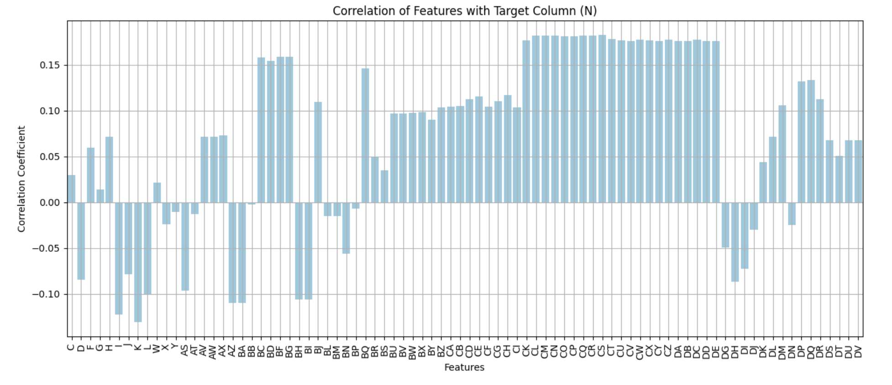
Co-relation
Data Encoding: Categorical features C[Series] and F[Strain gauge] were encoded using Ordinal Encoder for model compatibility.
Correlation Insights: Moderate correlations with the target variable N[Nominal Amplified Amplitude] were observed, but none were particularly strong, prompting the retention of diverse features for capturing complex interactions.

Slide 4
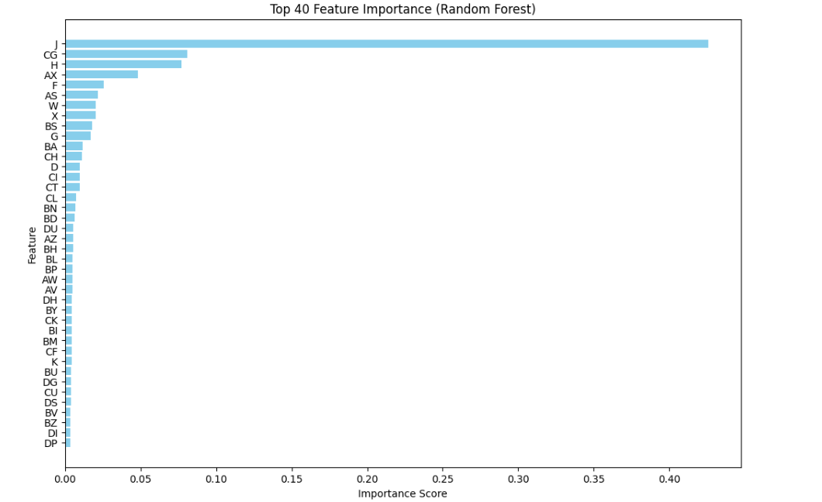
Feature Importance
Random Forest Model: Used to assess feature contributions to predictive power, plotting the top 40 features for visualization.
Key Insight: J[Frequency] emerged as the most significant feature, highlighting its substantial influence on the target variable and its critical role in model optimization.

Slide 5
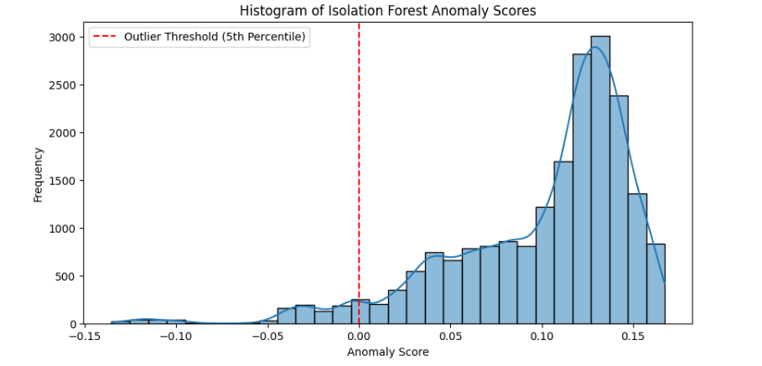
Outlier Analysis
Isolation Forest Algorithm: Outliers were detected using Isolation Forest with a contamination threshold of 5%.
Findings: 1,006 outliers were identified, but their removal showed no significant impact on model performance.
Decision: The full dataset, including outliers, was retained to preserve maximum data variability for model development.

Slide 6
Feature Engineering
Feature Binning
Refinement using Frequency
Hybrid Approach

Slide 7
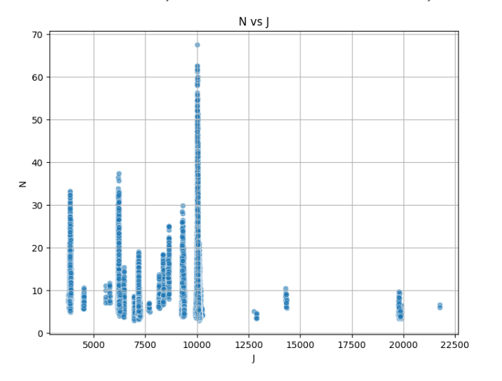
Feature Binning
Feature Analysis: After initial dropping of features M and R, J[Frequency] emerged as the most important feature for predicting N[Nominal Amplified Amplitude].
Impact: The insights from J’s[Frequency] importance guided subsequent feature engineering and model selection strategies.

Slide 8
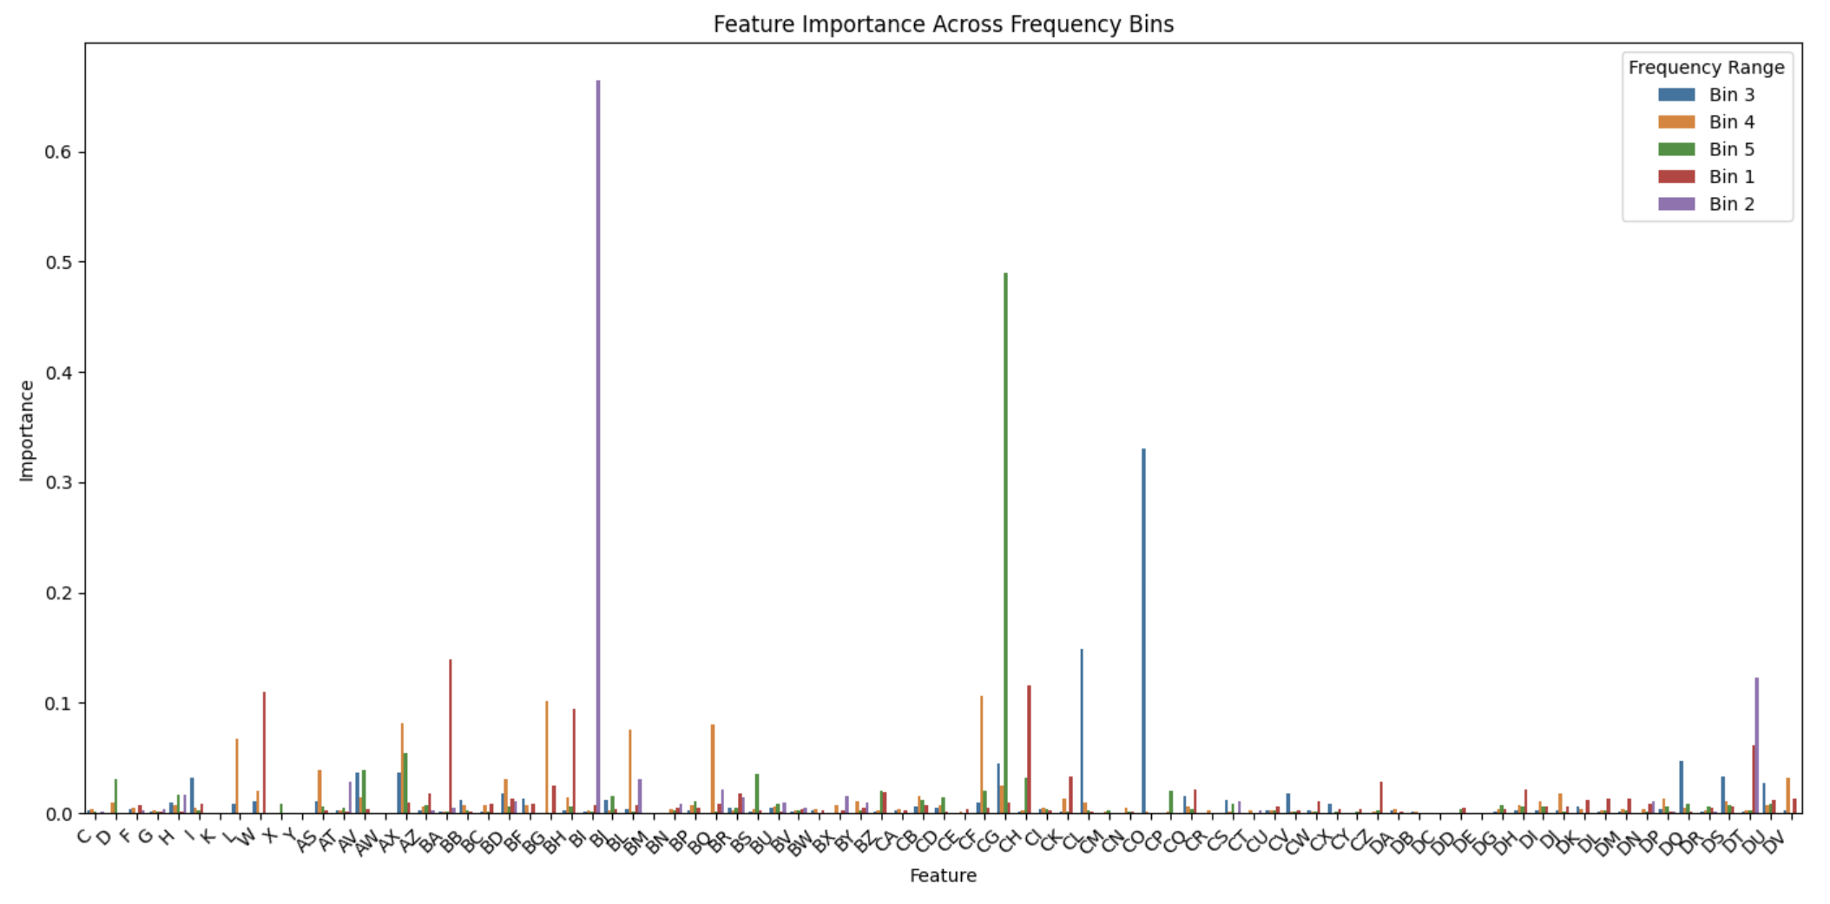
Feature Binning
Binning Strategy: The frequency range of J was divided into five bins with equal data points to evaluate feature importance patterns within each bin.
Modelling Efforts: A neural network trained on top 40 features per bin initially produced a high MSE of 52. An RNN improved accuracy but struggled with bins 4 [MSE-120] and 5 [MSE- 90] due to data sparsity.
Improvement: Switching to a Random Forest model reduced the MSE to 16, though bins 4 and 5 remained challenging, indicating a need for further refinement.

Slide 9
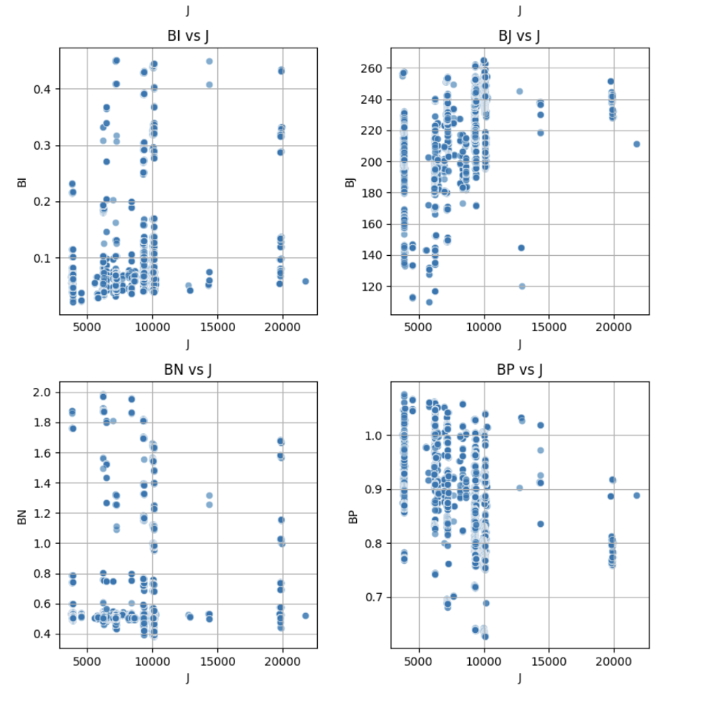
Refinement using J[Frequency]
Data Imbalance: The data distribution revealed a high concentration of points below 10,000 Hz and sparse data above this threshold.
Modelling Insight: This imbalance suggested that a single-model approach might not be optimal for accurate predictions.

Slide 10
Hybrid Approach
Dual-Model Approach: An RNN was used for data below 10,000 Hz due to prominent data availability, while a Random Forest model handled data above 10,000 Hz.
Feature Selection: Both models learned from the top 40 features without applying feature binning.
Performance Improvement: This hybrid strategy reduced the Mean Squared Error (MSE) from 16 to 13.7, enhancing predictive accuracy.

Slide 11
Best Model Working
Why This Model?
Model Working
Prediction Results

Slide 12
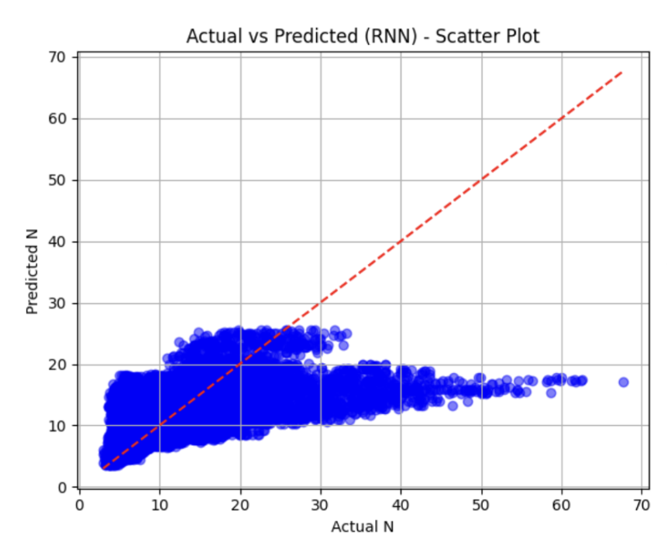
Why this Model?
Initial Model Challenges: The simple neural network achieved an MSE of 34 but struggled with higher value predictions, prompting experimentation with RNN, LSTM, GRU, and Bidirectional models.
Optimization Attempts: Hyperparameter tuning with Optuna slightly improved the LSTM model to an MSE of 28, but prediction issues persisted.

Slide 13
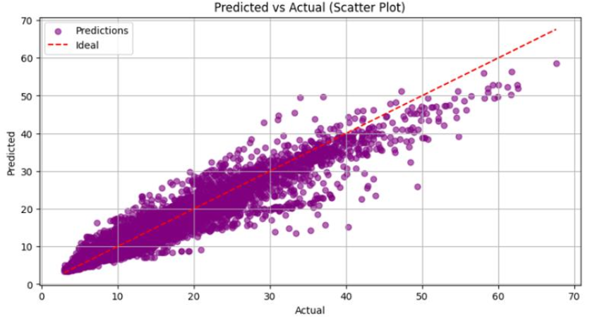
Why this Model?
Feature Binning Impact: Applying feature binning with the J [frequency] feature and training a Random Forest model improved predictions, reducing the MSE to 16.
Hybrid Strategy Success: Incorporating a dual-model approach using RNN for data below 10,000 Hz and Random Forest for data above it improved accuracy, reducing the MSE to 13.7.

Slide 14
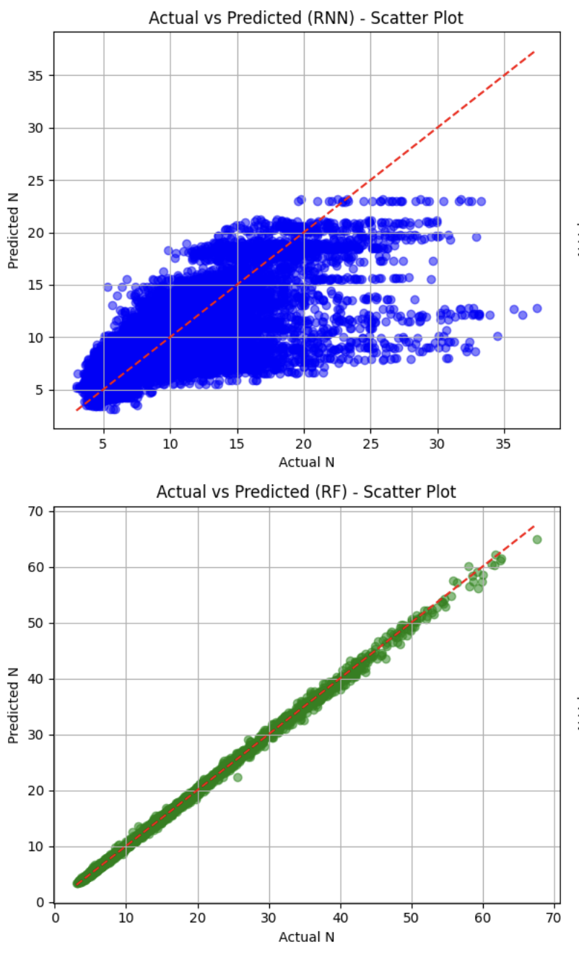
Model Working
Data Segmentation: The dataset was categorized into frequencies below and above 10,000 Hz for targeted modelling.
Model Training: RNN was optimized using Optuna, achieving a training loss of 0.068 and validation loss of 0.0701 (MAE – 2.39). For high-frequency data, Random Forest achieved an MAE of 0.2055.
Performance Evaluation: Scatter plots and line graphs revealed that the RNN was predicting better while the Random Forest demonstrated strong predictive performance for high-frequency data.

Slide 15
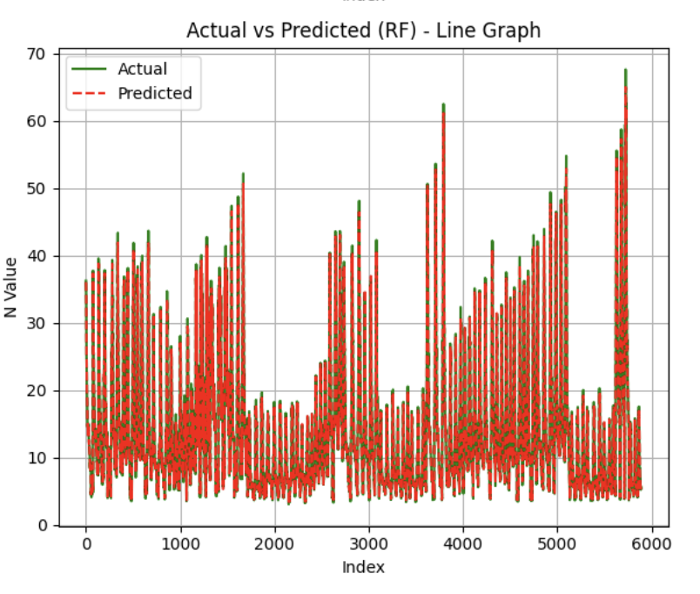
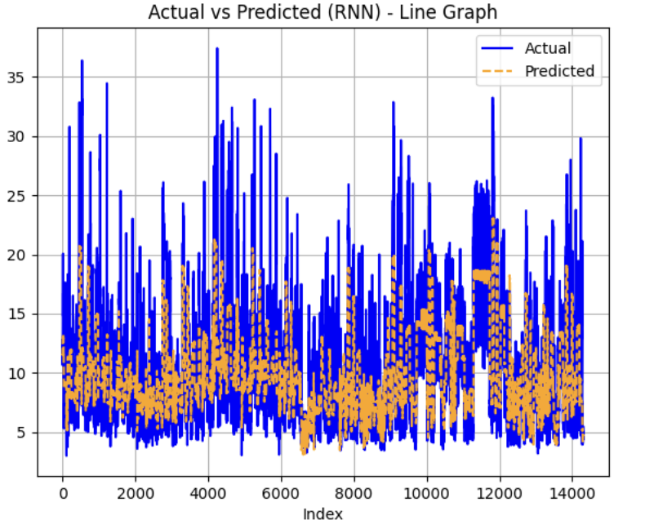
Model Working

Slide 16
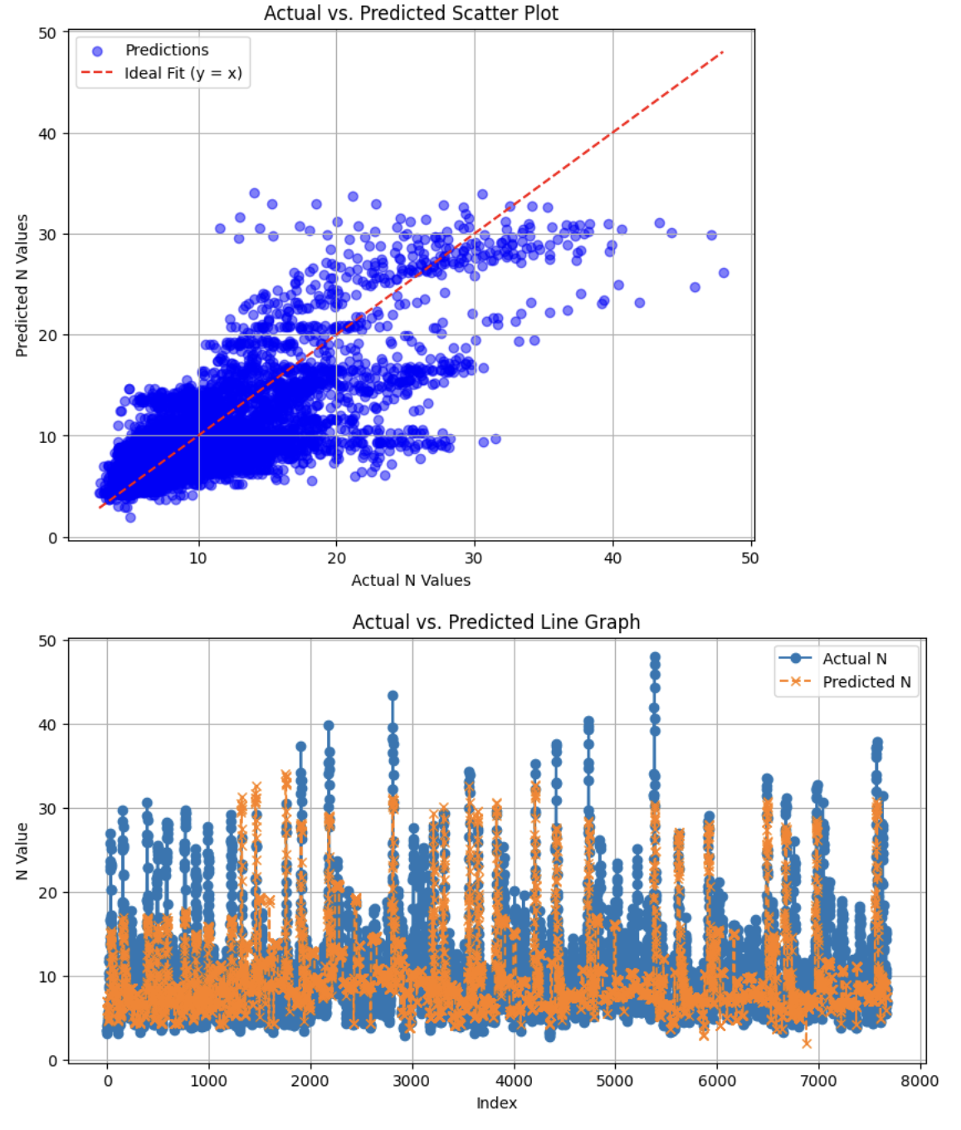
Prediction Result
Optimized RNN Parameters:
First RNN Layer Units: 1024
Second RNN Layer Units: 256
Dense Layer Units: 16
Learning Rate: 0.0005
Batch Size: 256
Performance Outcome: The optimized model achieved an MSE of 13.6 on an unseen dataset, demonstrating effective generalization.
Evaluation: Prediction graphs highlighted strong alignment between predicted and actual values, confirming the model’s accuracy.

Slide 17
Conclusion
Key Findings: Complex models like RNN, LSTM, and GRU struggled due to limited data and sparse distribution above 10,000 Hz, leading to high MSE.
Hybrid Approach: Combining RNN for lower frequencies and Random Forest for higher frequencies improved prediction accuracy and reduced MSE.
Future Directions: Expanding the dataset and refining feature engineering are essential for further improvements. Integrating mathematical relationships between features and the target variable can enhance model generalization and predictive accuracy.

Slide 18
Thank You

